Slide 1


Slide 2


The Problem
80 million
People with hearing loss in Africa
57m adults and 7m children
With hearing loss in sub-Saharan Africa
No audiologists
In 87% of African countries
There is no cost effective solution available

Slide 3
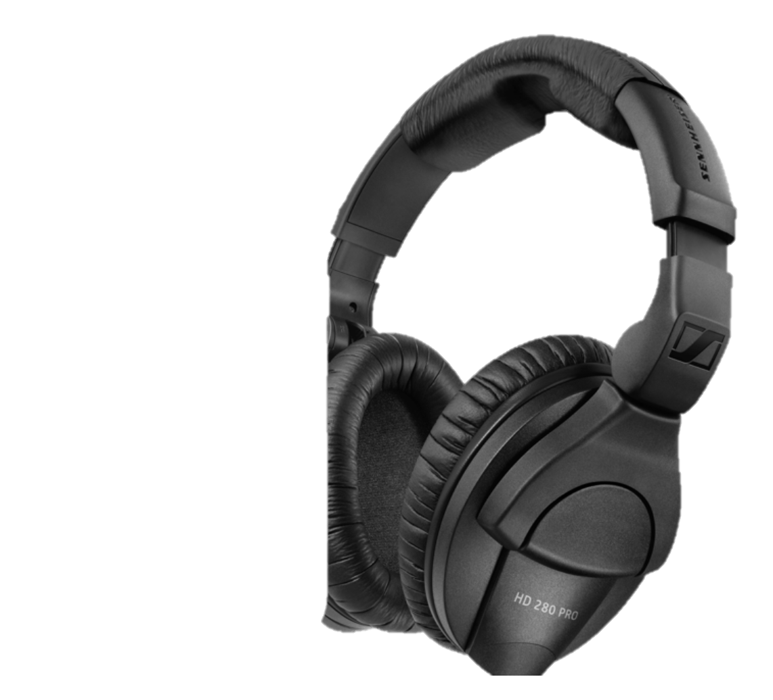


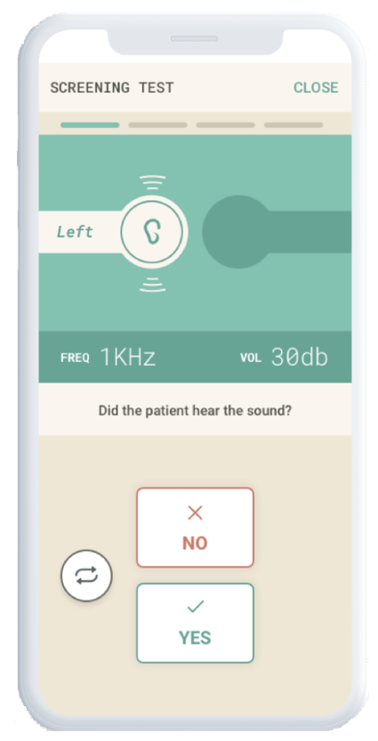
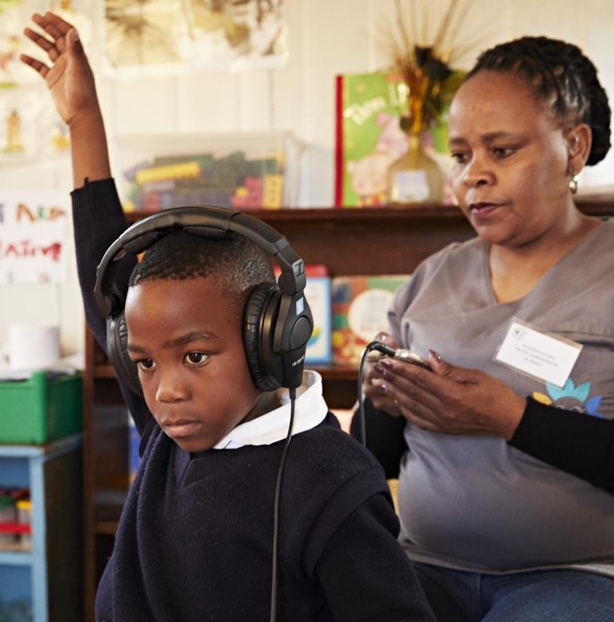
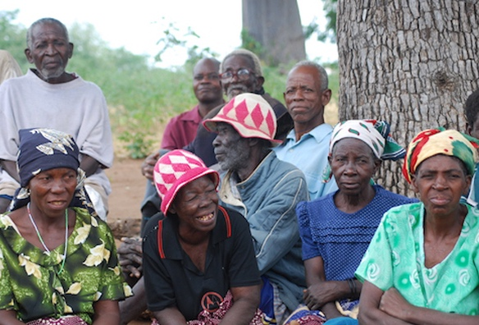
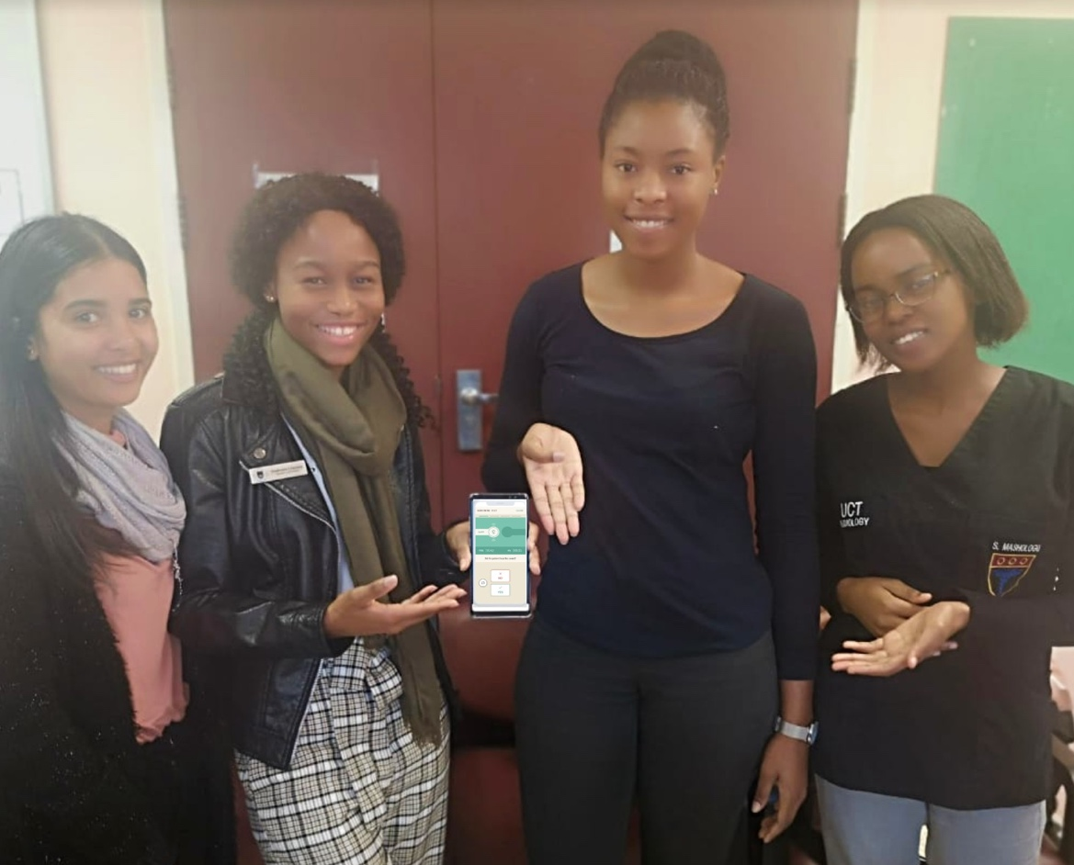
What We Do
Notes:
Lalela is able to provide a cost effective and time saving solution and business model that allows more healthcare practitioners and organisations to conduct more hearing tests at a lower cost.
We solve the problem of the unavailability of hearing tests to millions of people by providing a cost effective and time saving device to health care practitioners and organisations. We charge a subscription fee and use per-test billing, allowing them to test more people more often.

Slide 4
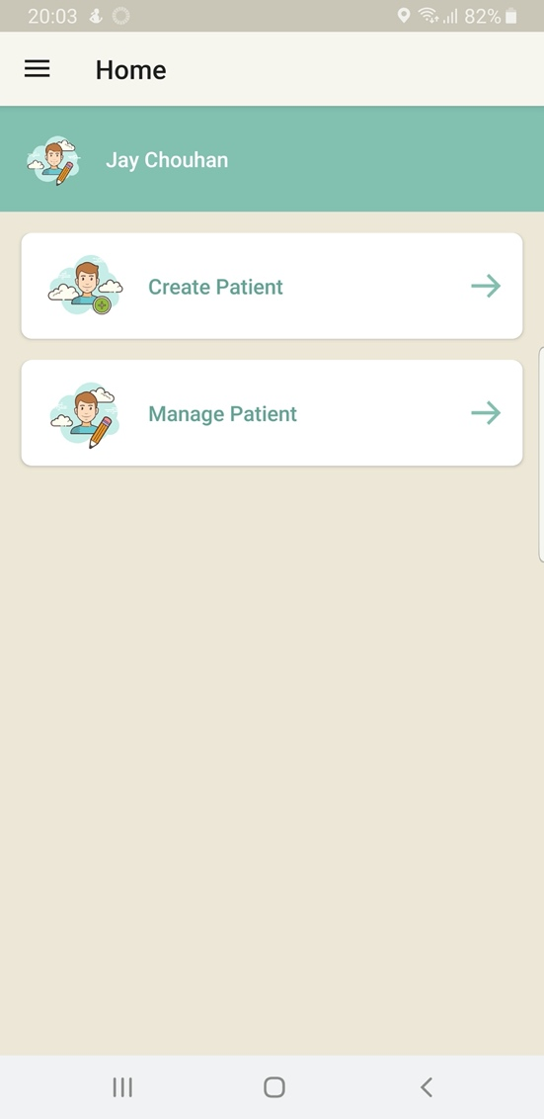
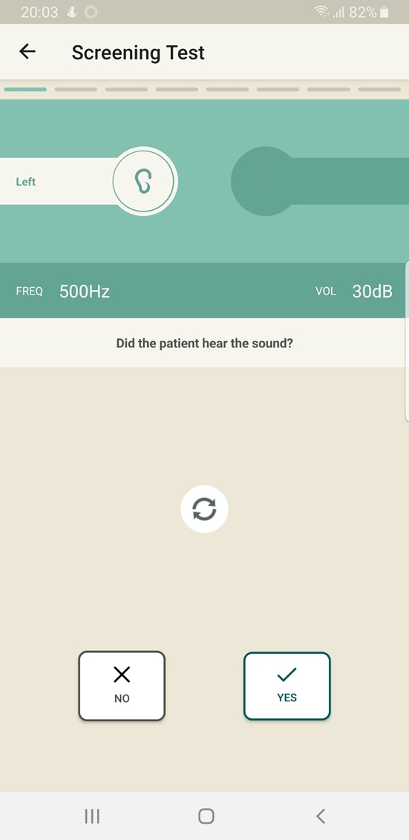
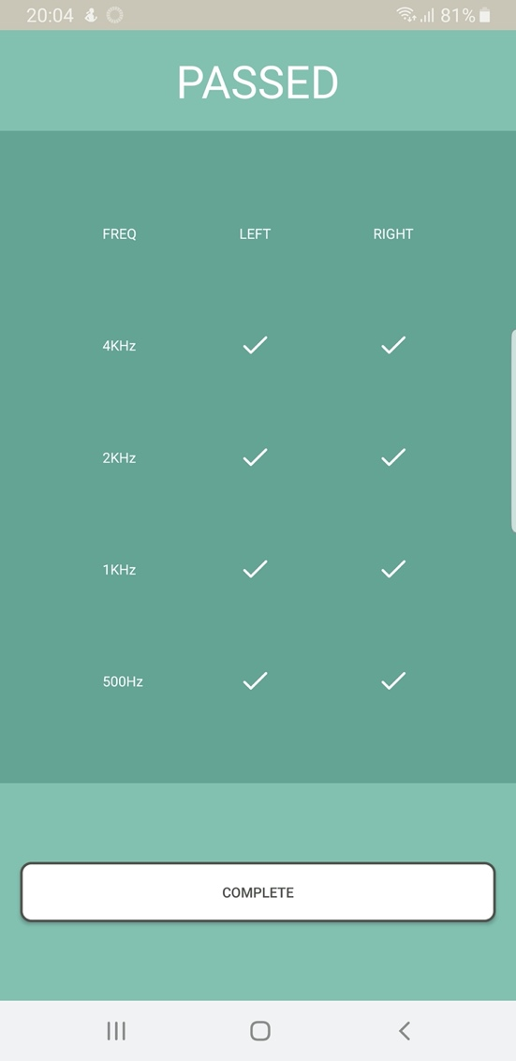
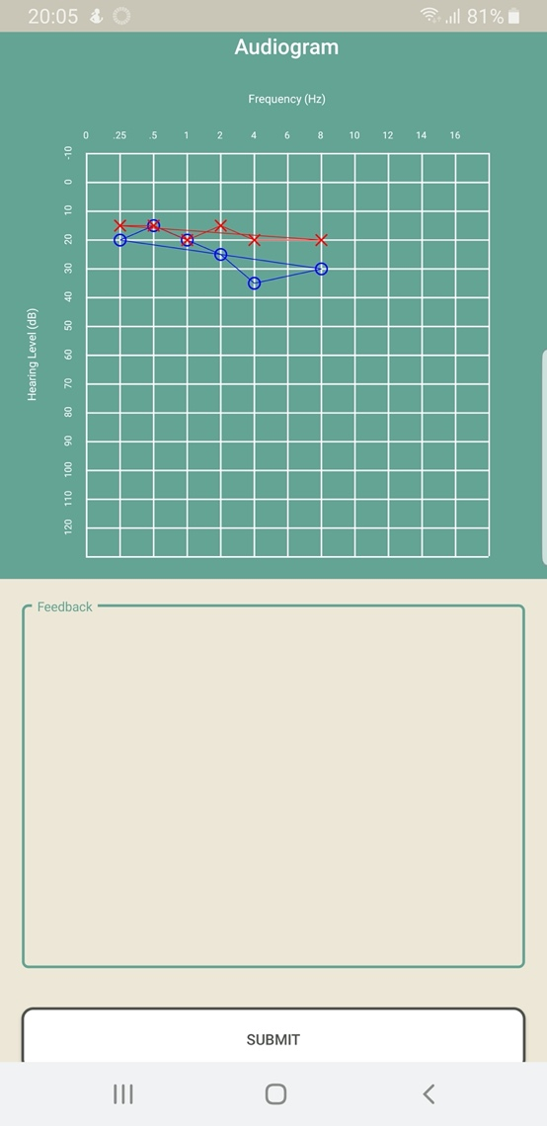
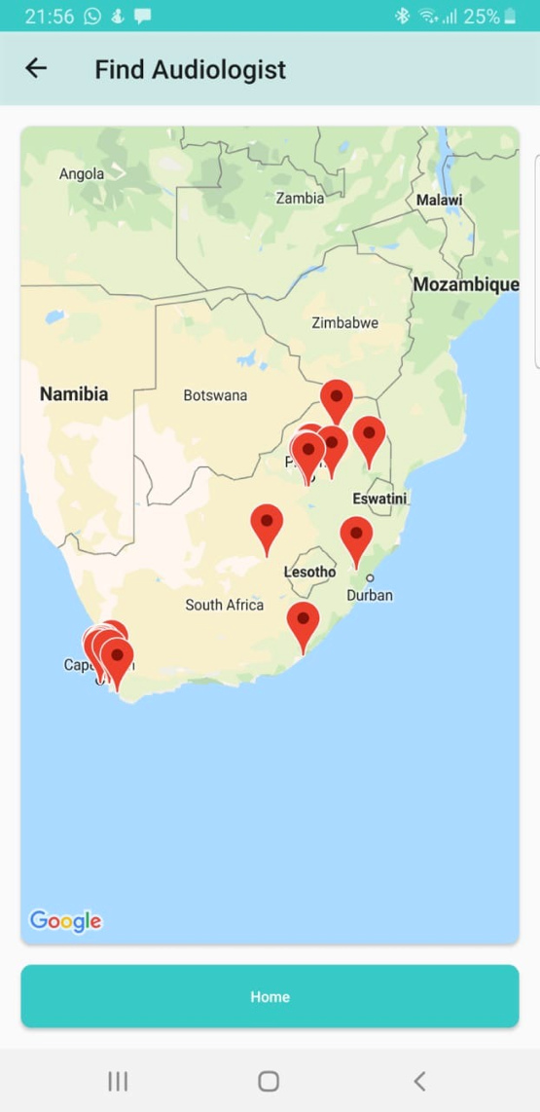
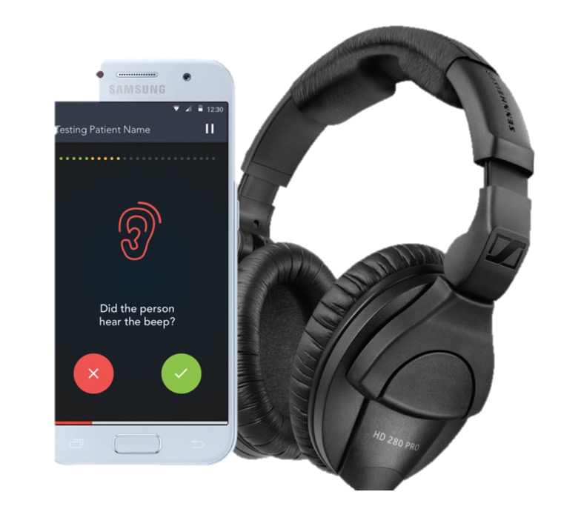
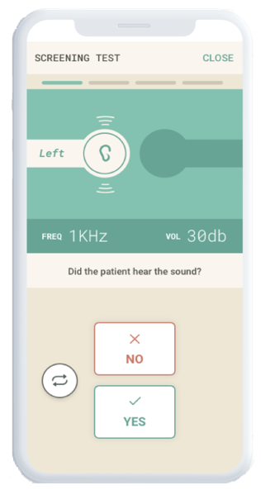
Lalela’s Product
Device
Open App
Test Hearing
Results
Refer
Limited training required to conduct medical graded hearing testing
Notes:
Lalela consists of a mobile phone, headphones and our innovative application. It allows users to test hearing easily and quickly, review results and create reports and refer patients to the nearest audiology service provider when hearing loss is detected.

Slide 5
Business Model
=
Lower software development costs
Flexible payment options
1 device for all tests
COST EFFECTIVE
Notes:
Lalela has adopted a cost leader approach. We are able to maintain this through our lower software development costs.
By providing flexible payment options and combing multiple devices and tests into one solution, we are more cost effective than the current competitors.

Slide 6


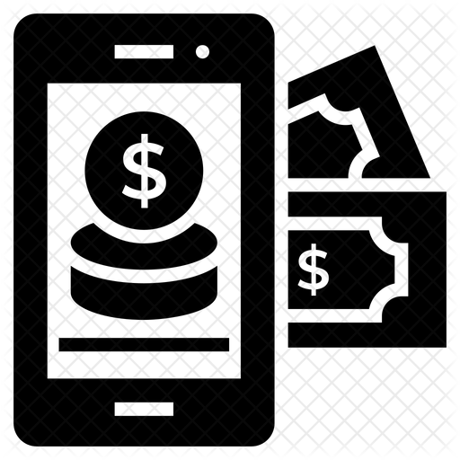
Revenue Streams
SUBSCRIPTIONS
PER TEST BILLING
DATA MONETISATION
Notes:
We have 3 revenue streams.
Subscriptions; making our solution more attractive and lowers entry cost for customers
Per test billing; to take full advantage of the the millions of tests that need to be conducted
Through device sales

Slide 7
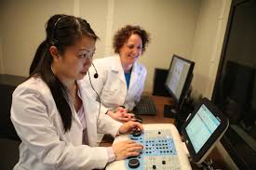









Target Customers
Individuals
Organisations
Audiologist | Speech Therapists | OHS
Universities | Wellness Clinics
Workload
Periodic
High volume
Pricing Needs
Flexible, subscription, low capital outlay
Annual licence / full purchase
Purchasing Power
Self-funded
Budget based
Notes:
We have identified 2 target customer segments
Individuals and organisations
Individuals comprise of audio, slps, ohs and require flexible payment options due to their limited purchasing power and fluctuating patient loads
Organisations comprise of unis and wellness clinic like those in Dischem and Clicks, which operate on budgets and need a product to fit into that budget, as they serve large communities

Slide 8
Pricing Options
Individuals
Organisations
Audiologist | Speech Therapists | OHS
Universities | Wellness Clinics
Pay-As-You-Go
2Yr Subscription
3Yr Capped
3Yr Uncapped
R8500 for Device
Device Included
R15 000 p.a.
R25 000 p.a.
20 Preloaded Tests
R549 pm
Device Included
Device included
R10 / Test
R10 / Test
3000 Tests/year
Unlimited tests
Notes:
We have identified 2 target customer segments
Individuals and organisations
Individuals comprise of audio, slps, ohs and require flexible payment options due to their limited purchasing power and fluctuating patient loads
Organisations comprise of unis and wellness clinic like those in Dischem and Clicks, which operate on budgets and need a product to fit into that budget, as they serve large communities

Slide 9
Marketing and Sales Strategy
ONLINE SALES
Using SEO, Google and Facebook Ads and professional website advertising to attract and drive traffic to online sales on website
WORD OF MOUTH
Word of mouth and referrals are the greatest source of sales in the industry
EXPERIENTIAL MARKETING
Allowing people to experience the product
Notes:
We have chosen to adopt 3 main marketing and sales strategies
1. Sales reps (at practices, professionals conferences and workshops)
Who will target professional practices, conferences and workshops, as these are the places where professionals usually get to know about new products in the industry

Slide 10
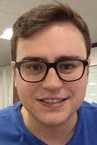
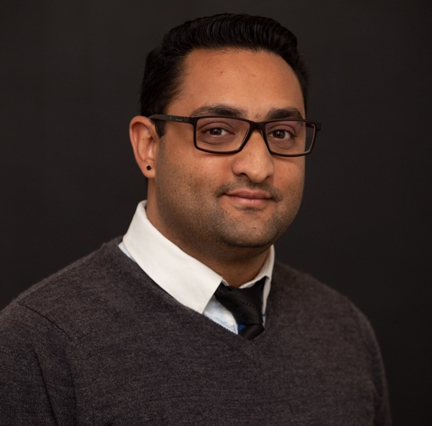
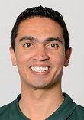
Our Team
Jean Pierre Le Roux
Jay Chouhan
Sebastian Prim
Co-Founder | CTO
Co-Founder | CEO
COO
Engineering | Developer
B.Eng. | MBA
Audiologist | Business
BSc | MSc | MBA
Physiology | Bus. Development
BSc (Hon.) | MBA
Application Development
IT Strategy & Expertise
Healthcare Expertise
Strategy & Administration
Business Development
Marketing & Sales

Slide 11
Beginning of E-Track Program
Business Plan
Research based business plan
Team
Proof of Concept
Established business core team
Proof of concept of application and device
Development Stage
Investor Interest
Development of front and back end of application still needed to be done
Expression of interest from several investors and users

Slide 12
Current Position E-Track Program
Traction
Identity
Interest to purchase and use device from individuals and organisations
Comprehensive and well thought out brand & corporate identity
Registered
Business
Improved Business Plan
Testing Phase
Device Ready
Business formally registered
Business plan is more accurate than before
Device is ready for field testing and almost ready for market
All components of device ready for calibration
IP Clearance
Administration
UI/UX
Certification
IP issues clarified and options established
Legalities of company addressed
User experience finalised and website created
Local manufacturing & distribution licence applied for

Slide 13
Next Steps
Sales & Marketing
Partnership and sales contract negotiation
Research & calibration to validate device against competitors
Investment/funding
Notes:
We are aware that our position as a cost leader may be challenged by competitors either by price matching or replicating similar software to us. To mitigate these risks, we will include value adding education and training services, creating a higher barrier to exit for users and differentiating ourselves through exceptional customer experience. Poor customer service is major pain point for clinicians as it affects their ability to deliver services to their patients and thus exceptional customer experience is key in this market.

Slide 14
Go To Market
Phase 1:
Market Entry and Penetration
Phase 2:
International & Local Expansion
Clinicians | OHS
Expand into Africa
Universities | Wellness Clinic
SA DoH and DoEd
Year 1 - 3
Notes:
We have a 4 phase got to market strategy.
Phase 1 sees us gain market acceptance through clinicians and OHS
Phase 2 is when we enter universities and wellness clinics
Phase 3 is when we enter the gov market through the tender process
And Phase 4 is when we expand into other African countries

Slide 15
3 Year Position
6 / 9
14 / 16
Presence in SA provinces
Presence in SADC
>R1 Mil
#1
Profit at end of year 3
Mobile audiology provider
Notes:
Looking at our revenue projections we see a growing trend over 10 years, with units sales reaching a plateau but subscription, licence and test revenue increasing over the 10 year period. This is expected as users will not buy additional units every year.

Slide 16
Thank You for Listening

